Slide 1
Database Management System
MD. ARIFUL ISLAM KHANDAKER
ASSISTANT PROFESSOR, IICT.
KUET

Slide 2
Outline
Purpose of Database Systems
View of Data
Data Models
Data Definition Language
Data Manipulation Language
Transaction Management
Storage Management
Database Administrator
Database Users
Overall System Structure

Slide 3
Database Definition
What is Database?
A database is basically just a computerized record-keeping system where data are stored in organized way.
The database itself can be regarded as a kind of electronic filing cabinet; i.e., it is like a repository or a container for a collection of computerized data files.

Slide 4
Difference between Data and Information
“Data” refer to what is actually stored in the database. It is unprocessed value.
“Information” refers to the meaning of that data as understood by some user. It is processed data.
Example- Simply 50 is data or value but if “the mark is 50”- is information.
But in language, the terms “data” and “information” are treated as synonymous.

Slide 5
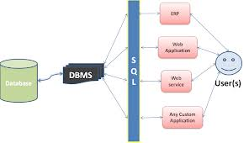
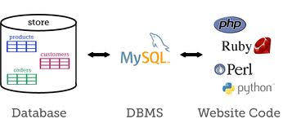
Database(Back End)

Slide 6
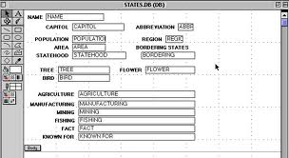
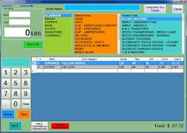
Database Access through forms

Slide 7
Components of Database System
A database system involves four major components:
1. Data - Integrated form, Shared form.
2. Hardware – Processor, Primary & Secondary Storage.
3. Software – Operating Systems, DBMS.
4. Users – Basically two types – Administrator, Normal User

Slide 8
Operations on Database file
Adding new, empty files to the database;
Inserting data into existing files;
Retrieving data from existing files;
Changing data in existing files;
Deleting data from existing files;
Removing existing files from the database.

Slide 9
Database System Applications
Banking: For customer information, accounts, and loans, and banking transactions.
Airlines: For reservations and schedule information.
Universities: For student information, course registrations, and grades.
Credit card transactions: For purchases on credit cards and generation of monthly statements.
Telecommunication: For keeping records of calls made, generating monthly bills, maintaining balances on prepaid calling cards, and storing information about the communication networks.
Finance: For storing information about holdings, sales, and purchases of financial instruments such as stocks and bonds.
Sales: For customer, product and purchase information.
Manufacturing: For management of supply chain and for tracking production of items in factories, inventories of items in warehouses/stores, and orders for items.
Human resources: For information about employees, salaries, payroll taxes and benefits, and for generation of paychecks

Slide 10
DBMS
What is DBMS?
A database-management system (DBMS) is a piece of software that is a collection of interrelated data and a set of programs to access those data.
The collection of data, usually referred to as the database, contains information relevant to an enterprise.
The primary goal of a DBMS is- to provide a way to store and retrieve database information that is both convenient and efficient

Slide 11
Advantages of DBMS
Data isolation: The DBMS can provide an abstract view of the data to isolate data from misuse.
Efficient data access: A DBMS utilizes a variety of sophisticated techniques to store and retrieve data efficiently.
Data integrity and Consistency: Integrity means condition apply to data. Provide some checks and key constraints not to data miss use. Consistency means before transaction and after transaction database will remain consistence.

Slide 12
Advantages of DBMS…
Data administration: When several users share the data, centralized control of data can offer significant improvements.
Concurrent access and crash recovery: A DBMS schedules concurrent accesses to the data in such a manner that users can think of the data as being accessed by only one user at a time. Further, the DBMS protects users from the effects of system failures.
Data Security: DBMS provides a robust security from the malicious destruction using authorization and authentic techniques.

Slide 13
File systems versus a DBMS
File System | DBMS
1. Operating system accesses data directly and it manages itself. | 1. Operating system can not access data directly when computer switch on.
2. It is Flat file which means it can be opened anywhere. | 2. It is not Flat file. Database Management System program needs to open data.
3. Operating systems provide only a password mechanism for security. This is not sufficient flexible to enforce security policies. | 3. DBMS provides security system for accessing data. That is why, improper user cannot access data randomly.
4. If the size of the file large (above 500GB), RAM size must be large. | 4. RAM size does not depend on data, because DBMS always selective type. That is required data are stored in RAM.
5. Concurrent access and crash recovery can not possible. Operating system does not responsible for this. | 5. A DBMS schedules concurrent accesses to the data in such a manner that users can think of the data as being accessed by only on user at a time. Further, the DBMS protects users from the effects of system failures.

Slide 14

View of Data
Abstraction: Data Abstraction means hiding basic data or meta data from all kind of users using views.

Slide 15
Levels of Abstraction
Physical level: describes how a record (e.g., customer) is stored.
Logical level: describes data stored in database, and the relationships among the data.
type customer = record
name : string;
street : string;
city : integer;
end;
View level: application programs hide details of data types. Views can also hide information (e.g., salary) for security purposes.

Slide 16
Instances and Schemas
Similar to types and variables in programming languages
Schema – the logical structure of the database
  e.g., the database consists of information about a set of customers and accounts and the relationship between them)
  Analogous to type information of a variable in a program
  Physical schema: database design at the physical level
  Logical schema: database design at the logical level
Instance – the actual content of the database at a particular point in time
Analogous to the value of a variable

Slide 17
Data Models
Model means structure. A collection of tools for describing
  data
  data relationships
  data semantics
  data constraints
Types of Data Models
Entity-Relationship model
Relational model
Other models:
  Object-oriented model
  Object relational data models
  Older models: network model and hierarchical model

Slide 18
Entity-relationship model
In software engineering, an entity-relationship model (ER model for short) is an abstract and conceptual representation of data.
Entity-relationship modeling is a database modeling method, used to produce a type of conceptual schema or semantic data model of a system, often a relational database, and its requirements in a top-down fashion. Diagrams created by this process are called entity-relationship diagrams or ER diagrams.
This article refers to the techniques proposed in Peter Chen's 1976 paper.

Slide 19

Entity-relationship model…
E-R model of real world
  Entities (objects)
    Example.-customers, accounts, bank branch
  Relationships between entities
    Example- Account A-101 is held by customer Johnson
    Relationship set depositor associates customers with accounts

Slide 20
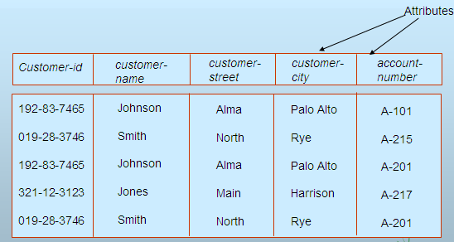
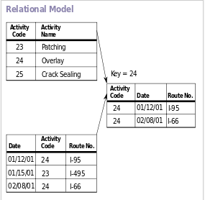
Relational Model
Relational Model is a tabular representation of ERD Model.
In this model all tables are related with some relations.
Example of tabular data in the relational model

Slide 21

A Sample Relational Database

Slide 22
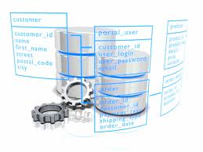
A Sample Relational Database

Slide 23
Database Language
Language is a way of communication.
Database Language means a way to communicate with Database and users.
Two types of Database Languages-
    Data Definition Language( DDL ),
    Data Manipulation Language ( DML).

Slide 24
Data Definition Language (DDL)
Specification notation for defining the database schema
  Example-
  create table account (
  account-number char(10),
  balance integer)
DDL compiler generates a set of tables stored in a data dictionary
Data dictionary contains metadata (i.e., data about data)
  Database schema
  Data storage and definition language
    language in which the storage structure and access methods used by the database system are specified
    Usually an extension of the data definition language

Slide 25
Data Manipulation Language (DML)
Language for accessing and manipulating the data organized by the appropriate data model
  DML also known as query language
Two classes of languages
  Procedural – user specifies what data is required and how to get those data
  Nonprocedural – user specifies what data is required without specifying how to get those data
SQL is the most widely used query language

Slide 26
SQL
SQL: widely used non-procedural language
  E.g. find the name of the customer with customer-id 192-83-7465
  select customer.customer-name
  from customer
  where customer.customer-id = ‘192-83-7465’
  E.g. find the balances of all accounts held by the customer with customer-id 192-83-7465
  select account.balance
  from depositor, account
  where depositor.customer-id = ‘192-83-7465’ and
  depositor.account-number = account.account-number
Application programs generally access databases through one of
  Language extensions to allow embedded SQL
  Application program interface (e.g. ODBC/JDBC) which allow SQL queries to be sent to a database

Slide 27
Database Users
Users are differentiated by the way they expect to interact with the system
Application programmers – interact with system through DML calls
Sophisticated users – form requests in a database query language
Specialized users – write specialized database applications that do not fit into the traditional data processing framework
Naïve users – invoke one of the permanent application programs that have been written previously
  E.g. people accessing database over the web, bank tellers, clerical staff

Slide 28
Database Administrator
Coordinates all the activities of the database system; the database administrator has a good understanding of the enterprise’s information resources and needs
Database administrator's duties include:
  Schema definition
  Storage structure and access method definition
  Schema and physical organization modification
  Granting user authority to access the database
  Specifying integrity constraints
  Acting as liaison with users
  Monitoring performance and responding to changes in requirements

Slide 29
Transaction Management
A transaction is a collection of operations that performs a single logical function in a database application
Transaction-management component ensures that the database remains in a consistent (correct) state despite system failures (e.g., power failures and operating system crashes) and transaction failures.
Concurrency-control manager controls the interaction among the concurrent transactions, to ensure the consistency of the database

Slide 30
Storage Management
Storage manager is a program module that provides the interface between the low-level data stored in the database and the application programs and queries submitted to the system.
The storage manager is responsible to the following tasks:
  interaction with the file manager
  efficient storing, retrieving and updating of data

Slide 31

Overall System Structure

Slide 32

Application Architectures
Two-tier architecture: E.g. client programs using ODBC/JDBC to communicate with a database
Three-tier architecture: E.g. web-based applications, and applications built using “middleware”

Slide 33
Thanks to All

